Slide 1
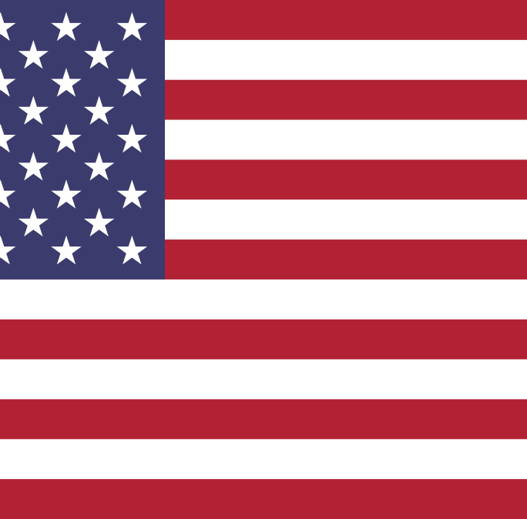
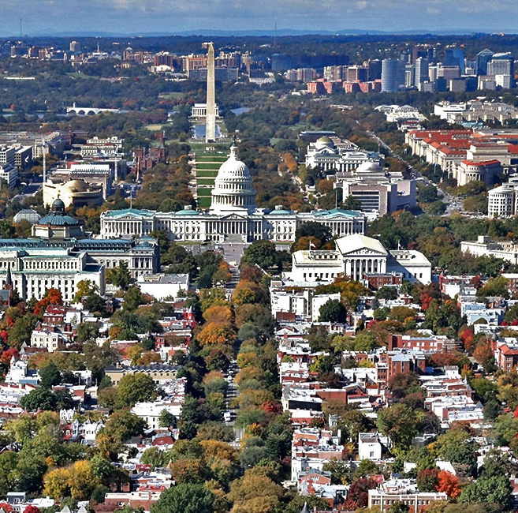
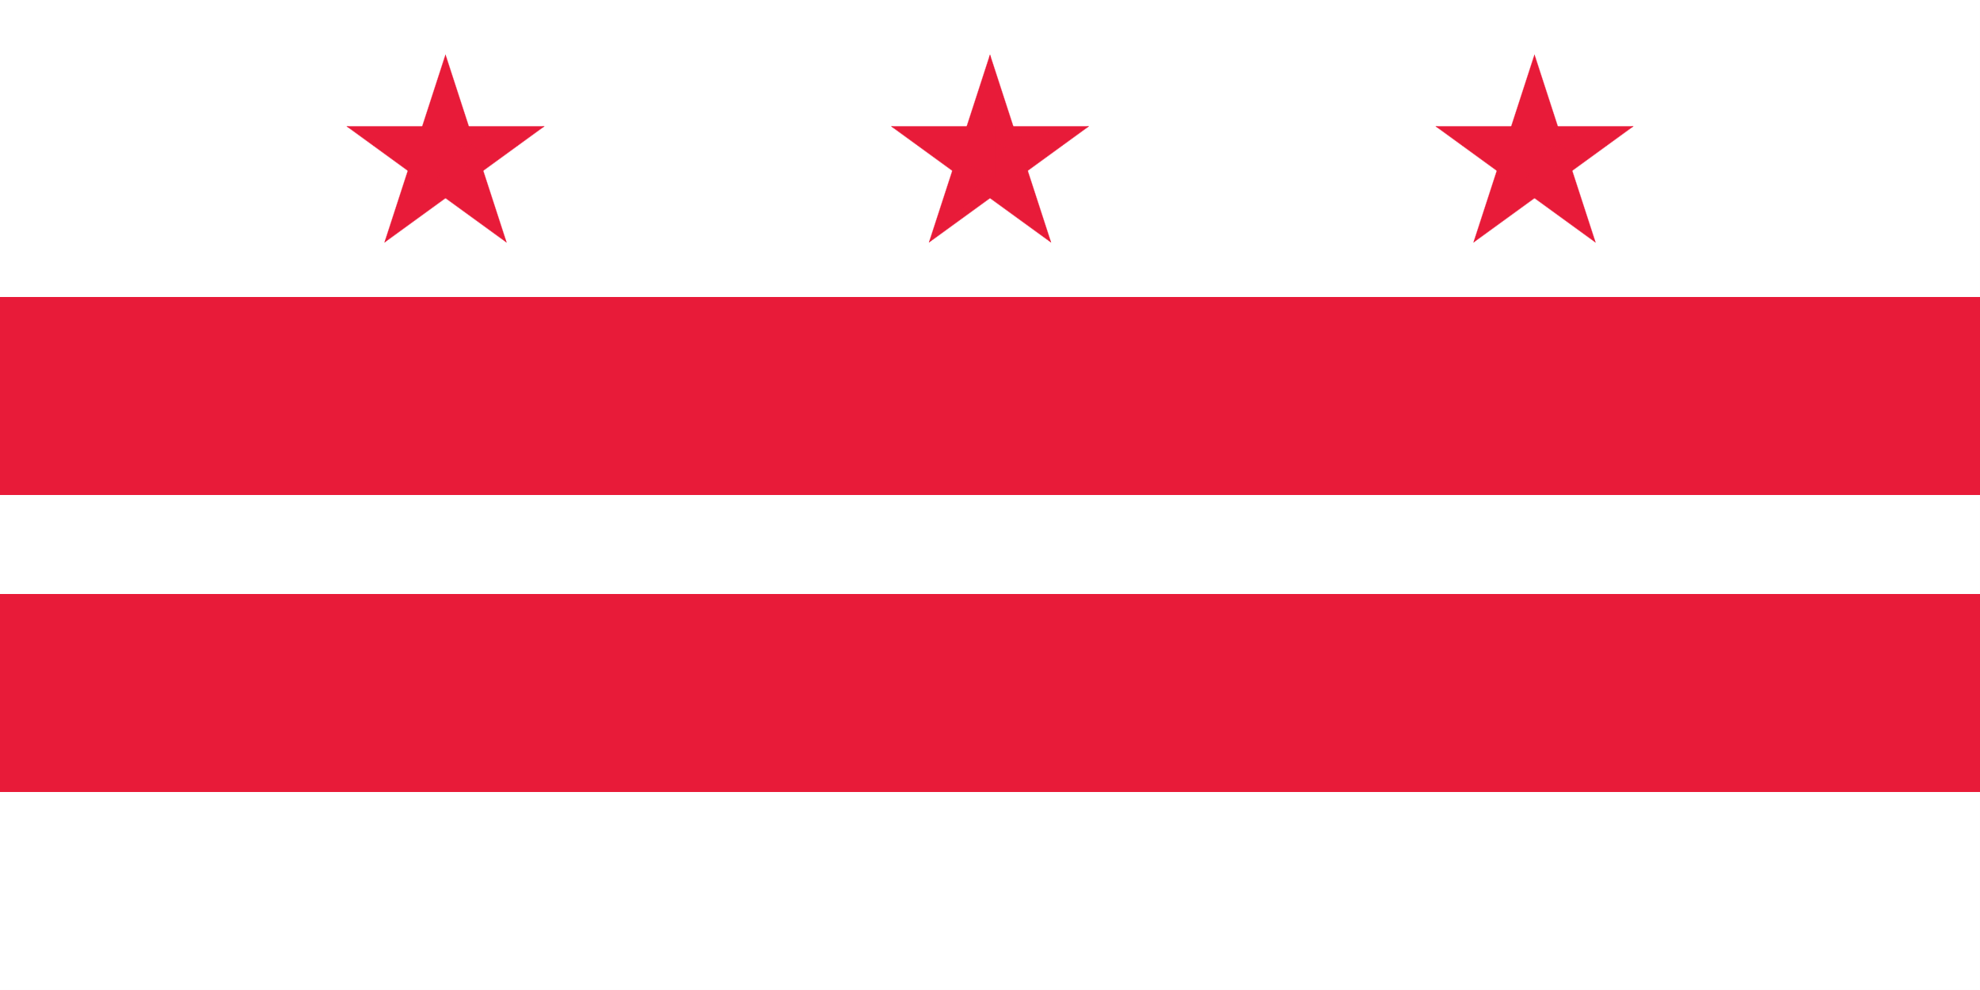
Washington D.C.

Slide 2
Introduction
District of Columbia: commonly called Washington City is famous for being the captital city of the United States of America.

Slide 3
History
Washington D.C. was founded after George Washington, one of the founding fathers and first president of the U.S.A.
It was founded on the 16th of July 1790, after the congress had approved the creation of a national capital.
It was designed by the French architect Pierre Charles L'Enfant.

Slide 4
White House
One of the most important building the city hosts is the White House: the official resisdence of President of U.S.A.

Slide 5
Important Monuments
The Washington Monument:
is an obelisk on the National Mall (near the White house) built to commemorate George Washington.
Korean War Veterans Memorial:
it is a monument created to remember the Korean War veterans between Koreans and Americans.

Slide 6
Important Places
George Washington University:
Founded in 1821, it is a major private university with three campuses.
Lincoln Memorial:
is a memorial that honors the 16th president of the United States: Abraham Lincoln.

